Slide 1
Modeling and Analyzing Predictive Booking Completeness and Determining the most Determining Factors.

Slide 2
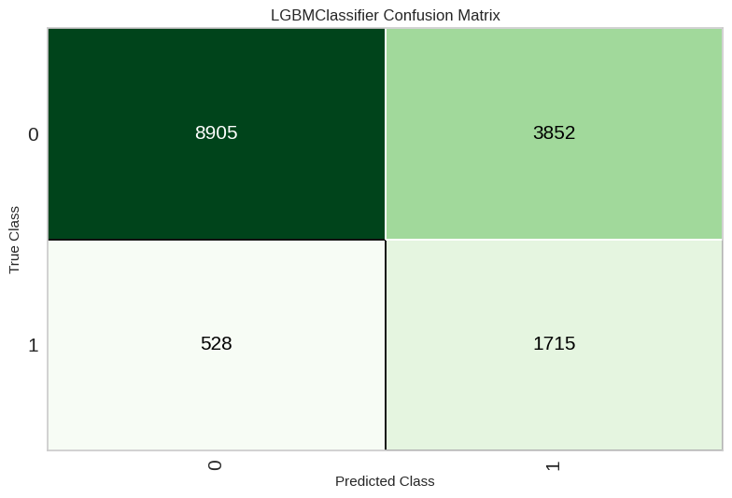
Modelling with LGBM Classifier
From the results obtained, the model has 84% Accuracy, 79% AUC, Recall 0.17, Precision 0.47, F1 0.25, Kappa 0.18, MCC 0.21.
Model can predict True Negative (Model predicts booking not completed correctly): 8905, False Negative (Model predicts booking not completed but incorrect): 528, True Positive (Model predicts booking completed correctly): 1715, True Negative (Model predicts booking completed but wrong): 3852

Slide 3
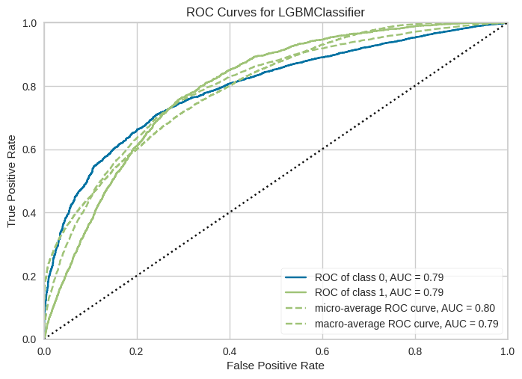
ROC CURVES
ROC curves for Class 0 and Class 1: The dashed blue curve represents the model performance for class 0, while the solid green curve represents the performance for class 1. Both curves have the same AUC (0.79), indicating comparably good performance for both classes.
Micro-Average and Macro-Average curves: The dotted yellow curve represents the micro-average with an AUC of 0.80, while the dashed cyan curve represents the macro-average with an AUC of 0.79. Both give an idea of the overall performance of the model.

Slide 4
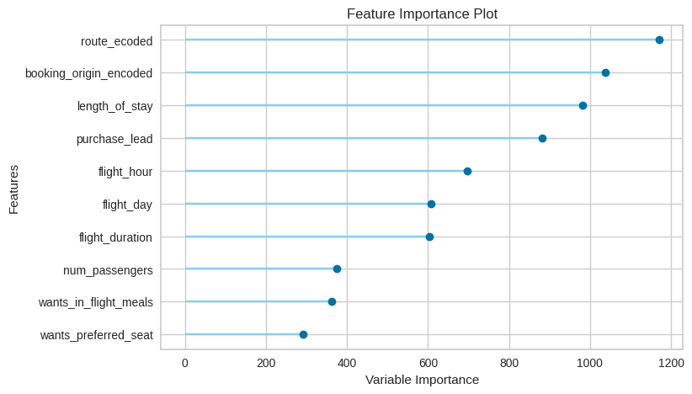
Features Importance
From the modeling results using LGBM. The features that have the most influence on the target booking complete are: Route, Booking Origin, Length of Stay, Purchase Lead, Flight Hour, and Flight Day.

